Slide 1


Fire and Smoke
Detection using
CNN with Keras
by
Avinash Mulapalli - 23MAS10002
P Abhinav sai - 23MAS10006
Ankit Varma - 23MAS10016
Syed Maaz - 23MAS10025
K Dilleswara Rao - 23MAS10029

Slide 2
Introduction
Global Wildfire Impact
• Causes significant economic and environmental damage.
• Climate change exacerbates effects.
Fire Alarm System Overview
• Warns people in emergencies.
• Can be activated automatically or manually.
• Alarms can be motorized bells, wall mountable sounders, horns.
• Speaker strobes sound alarm followed by voice evacuation message.

Slide 3

Dataset Description
Hierarchical Structure
Data Diversity
The dataset follows a hierarchical structure, with broader categories at the top and related images underneath.
The dataset contains a wide variety of samples across multiple classes, ensuring both Fire, Non-Fire, Smoke, Non-Smoke
Representative Samples
Each class in the dataset has a sufficient number of representative samples, allowing for effective model training and evaluation.

Slide 4
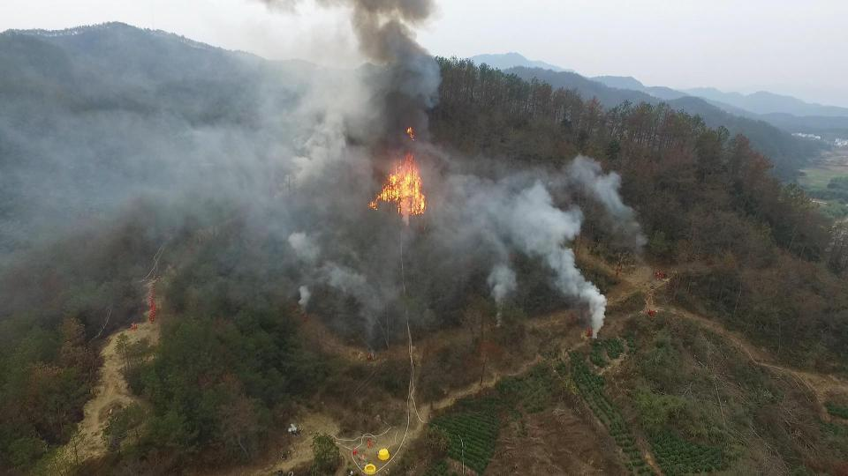
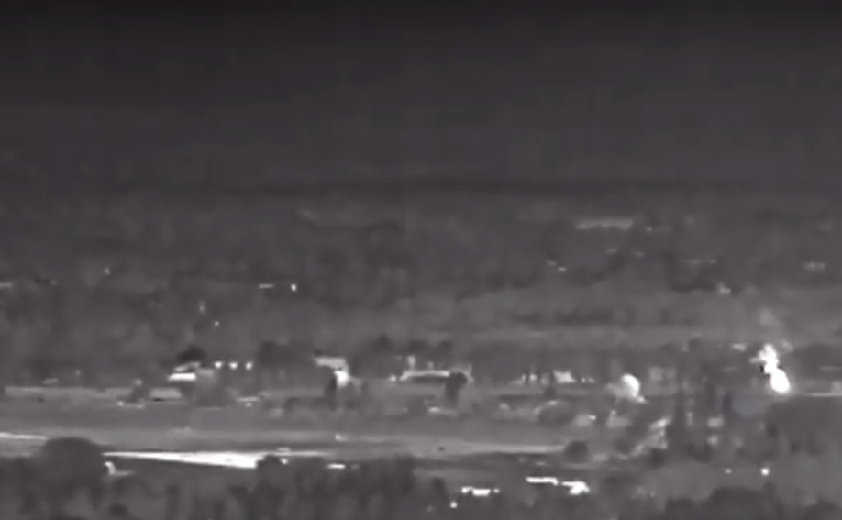
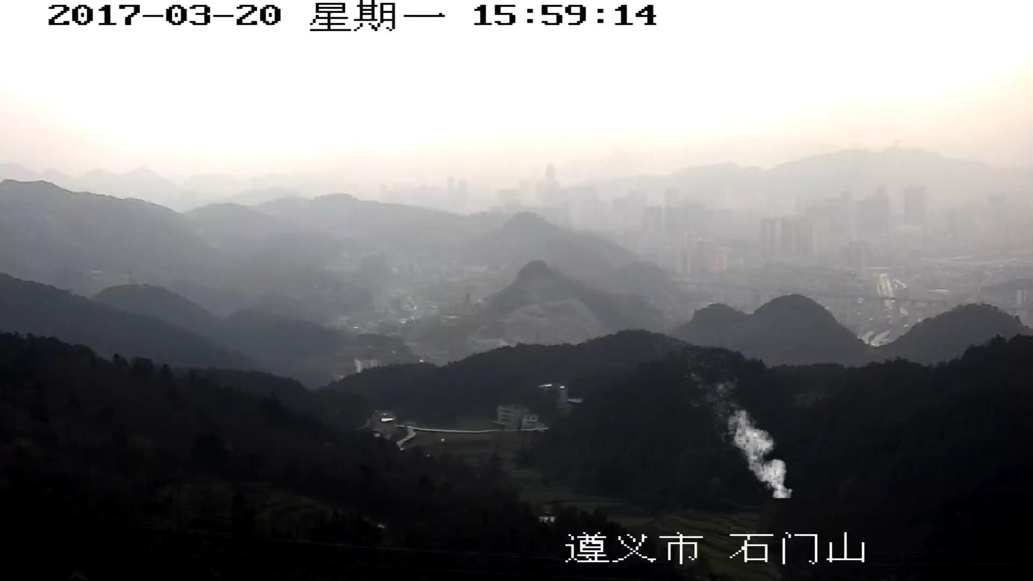
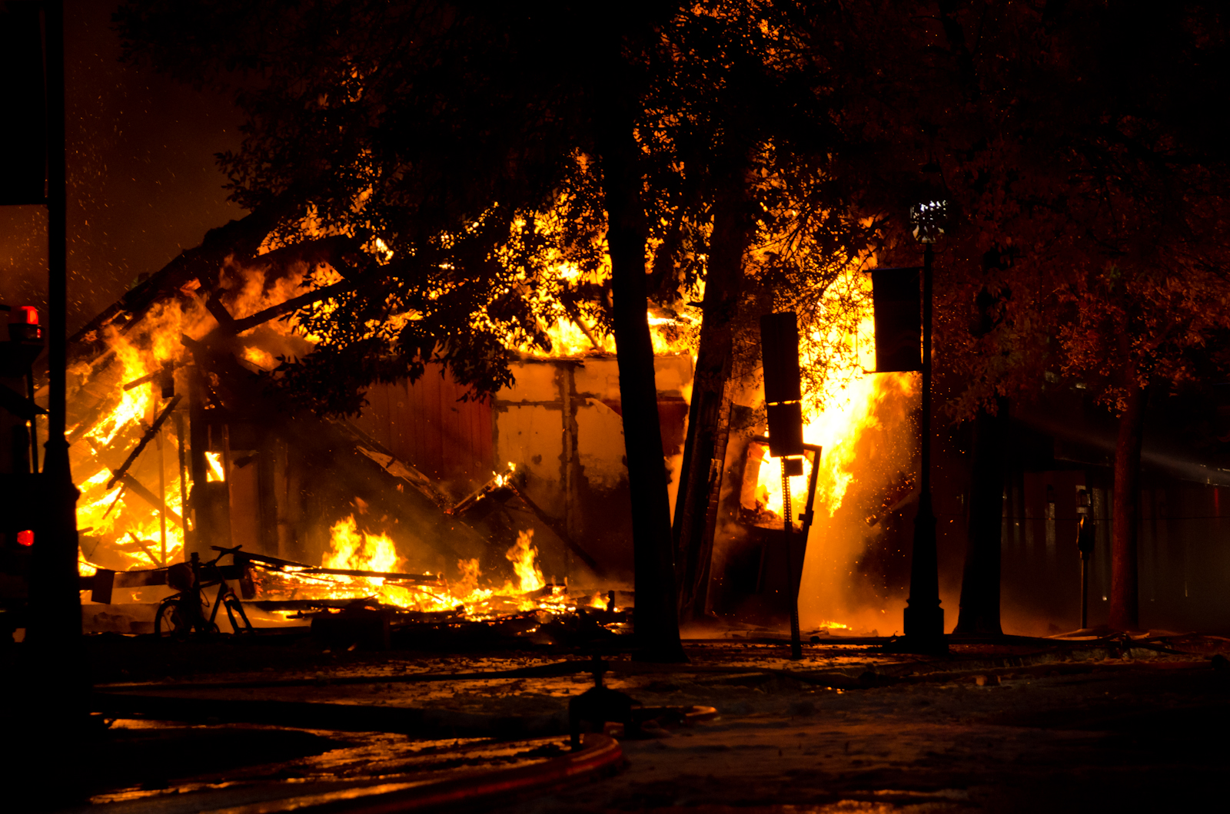
Sample from Each Class
test_big
test_small
train_smoke
train_fire
A sample image from the test folder shows he presence of smoke and fire
This sample image belongs to smaller test folder with fake and real smoke images.
This section of dataset is for training that shows presence of smoke
The section trains the model on images having actual fire in it

Slide 5

Model Creation
Model Name: InceptionResNetV2
Base Model: Pre-trained InceptionResNetV2 without top layers, using ImageNet weights.
Batch Normalization: Applied to normalize base model's output.
Dense Layer: 256-unit dense layer with ReLU activation and L1/L2 regularization.
Dropout: Rate of 0.45 dropout for regularization.
Output Layer: Dense layer with 2 classes
Activation: softmax for classification.
Model Compilation: Adamax optimizer with LR=0.001, categorical cross-entropy loss, accuracy metric.

Slide 6
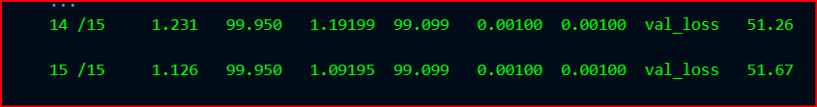
Model Training
Model Testing

Slide 7
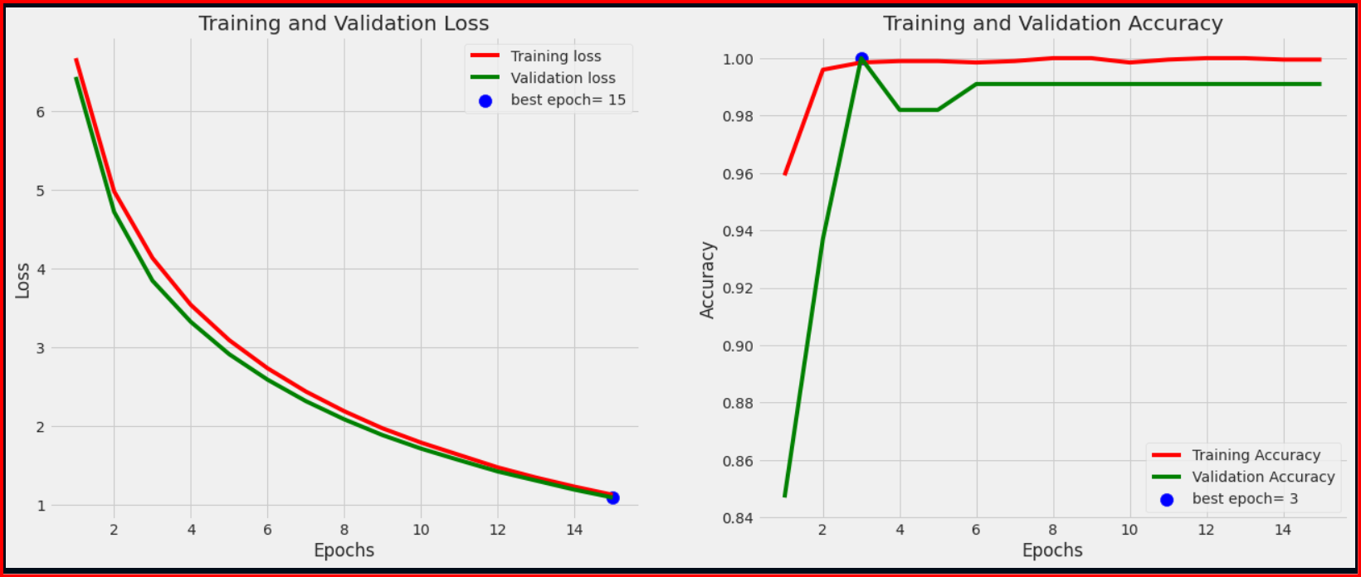
Prediction Result

Slide 8
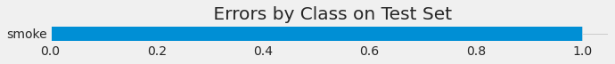
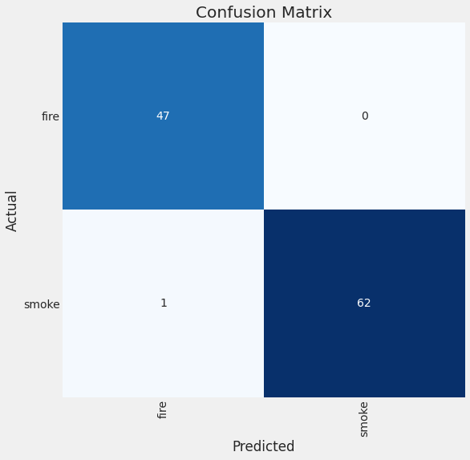
Confusion Matrix
Classification Report:
 | precision | recall | f1-score | support
fire | 0.98 | 1.00 | 0.99 | 47
smoke | 1.00 | 0.98 | 0.99 | 63
accuracy |  |  | 0.99 | 110
macro avg | 0.99 | 0.99 | 0.99 | 110
weighted avg | 0.99 | 0.99 | 0.99 | 110

Slide 9

Conclusion
Training:
Base Model: InceptionResNetV2, training without top layers
15 epochs were conducted.
Evaluation Metrics:
Final Training Loss: Ranged from 6.670 to 1.126.
Final Training Accuracy: Ranged from 95.915% to 99.950%.
Validation Loss: Ranged from 1.09195 to 6.43146.
Validation Accuracy: Ranged from 84.685% to 100.000%.
Model Test Accuracy: 99.09%.

Slide 10
Thank You

